Slide 1
MSCA Agentic RAG – Day 1
Renato Rocha Souza, Liad Magen

Slide 2

Agenda
RAG Strategies and benefits
Implementing RAG with OpenAI APIs
Creating a basic RAG enabled agent

Slide 3


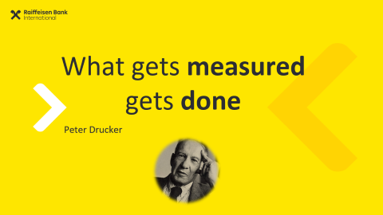

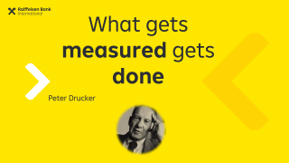


Agenda

Slide 4
End of Day
Reflection

Slide 5

NLP is a Hard Task
Even in the era of LLMs

Slide 6
Why is NLP hard?
!
Negativity & Restrictiveness
Meaning
Ambiguity
Variability
Language

Slide 7
Variability
Lexical
I loooooove it! everytime → every time oscar nom’d doc → Oscar-nominated documentary is bananas → is great
2m 2ma 2mar 2mara 2maro 2marrow 2mor 2mora
2moro 2morow 2morr 2morro 2morrow 2moz 2mr
2mro 2mrrw 2mrw 2mw tmmrw tmo tmoro tmorrow
tmoz tmr tmro tmrow tmrrow tmrrw tmrw tmrww tmw
tomaro tomarow tomarro tomarrow tomm
tommarow tommarrow tommoro tommorow
tommorrow tommorw tommrow tomo tomolo tomoro
tomorow tomorro tomorrw tomoz tomrw tomz

Slide 8
Variability
Semantical / Pragmatical
He acquired it He purchased it He bought it It was bought by him It was sold to him She sold it to him She sold him that

Slide 9
Negativity & Restrictiveness
Martin is a Data Scientist
Martin is not a data Scientist
Martin is a great Data Scientist
Martin is not a great data scientist
Martin is not a Data Scientist
Martin is not a Mad Scientist

Slide 10
Negativity and Restrictiveness
David was not the CEO
of Microsoft
from 2005
to 2010

Slide 11
Real-World Knowledge
Winograd Schema Challenge:
The trophy didn’t fit in the bag because it was too small The trophy didn’t fit in the bag because it was too big
The city councilmen refused the demonstrators a permit because they feared violence. The city councilmen refused the demonstrators a permit because they advocated violence.
The man couldn’t lift his son because he was too weak The man couldn’t lift his son because he was too heavy

Slide 12

Ambiguity
I ate pizza with olives
I ate pizza with friends

Slide 13
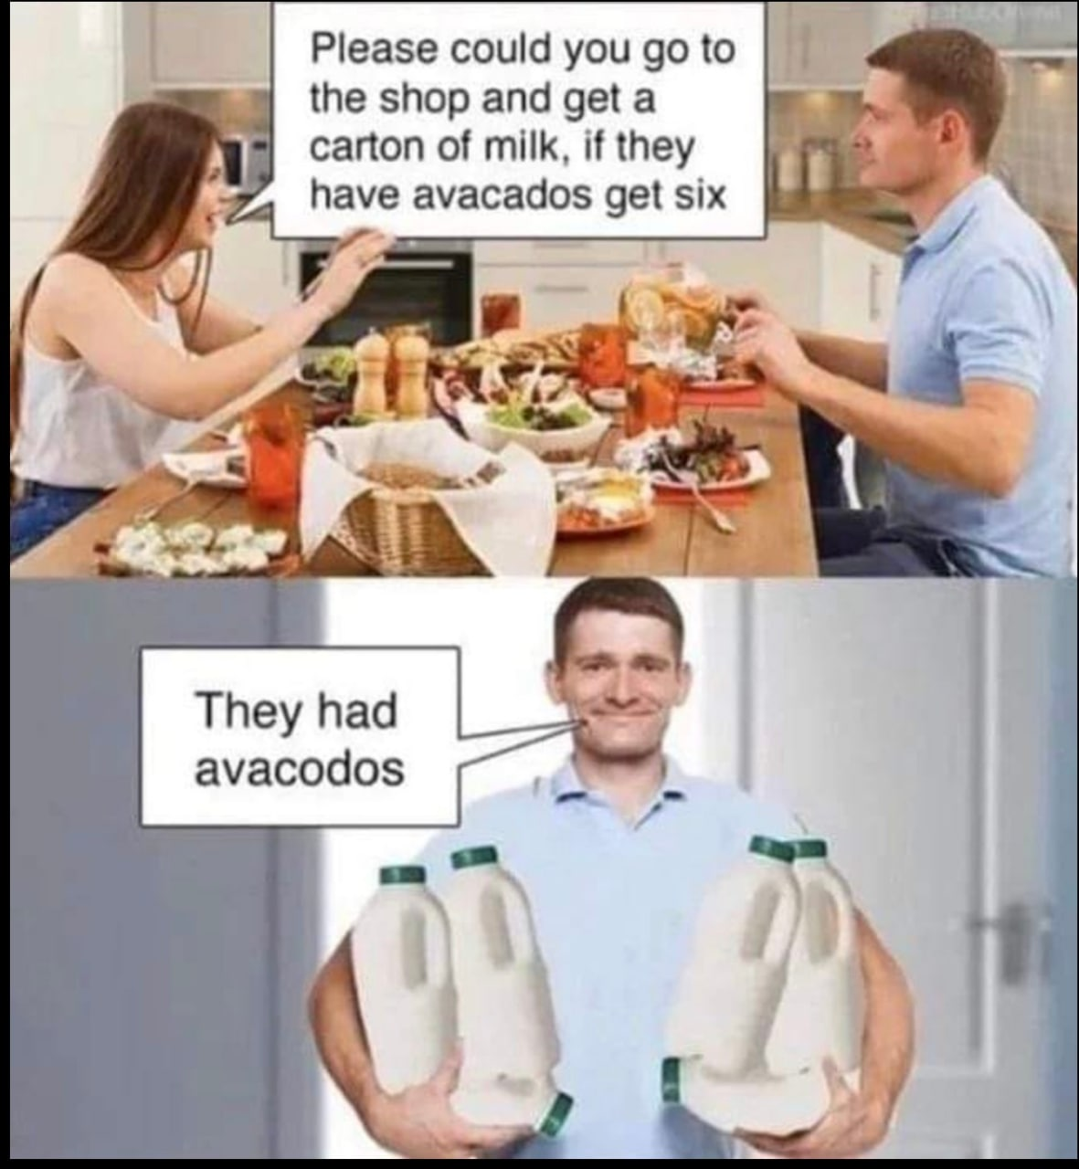
Ambiguity
I saw a girl playing baseball with a bat

Slide 14
Where?
Sheldon: Name your price.
Amy: Kiss me where I’ve never been kissed before.
Sheldon: You mean like Salt Lake City?
Amy: Nevermind…

Slide 15
Extreme Ambiguity (Real Headlines!)
Scientists count whales from space
The pope's baby steps on gays
Girl hit by car in the hospital
Iraqi head seeks arms
Students get first hand job experience
Squad helps dog bite victim
Miners refuse to work after death
Stolen painting found by tree
Actor sent to jail for not finishing sentence
Ban on Nude Dancing on Governor's Desk
Stadium air conditioning fails — Fans protest
Kids Make Nutritious Snacks

Slide 16

Ambiguity + Restrictivity

Slide 17
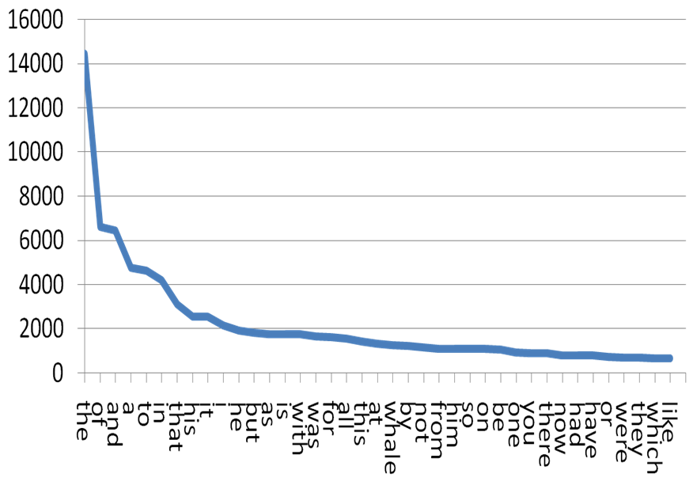
Zipf’s Law

Slide 18
Takeaways
How would these affect retrieval?

Slide 19
Takeaways
Ambiguity
Variability
Restrictiveness + Negativity
Zipf’s Law

Slide 20
Retrieval is Key

Slide 21
LLMs Limitations
What can’t LLMs do?
Where do they fail?

Slide 22
Large Language Models are Limited
Knowledge Cut-off
Hallucinations
Data Privacy / GDPR / HIPAA
Limited Context Window

Slide 23
Solution? Connect it to a Search Engine!
But…
How do Search Engines Work?

Slide 24
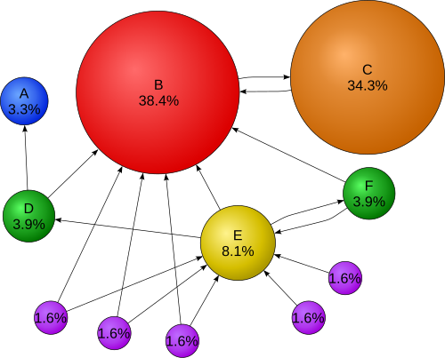

Slide 25
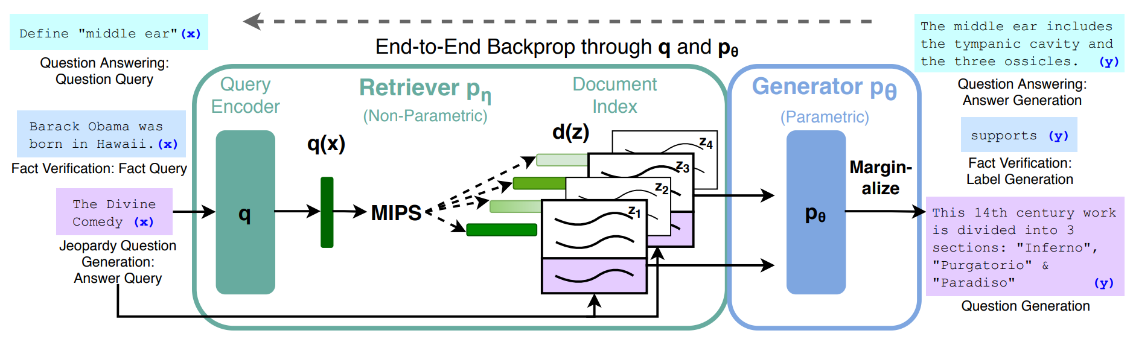
Retrieval-Augmented Generation (RAG) - 2021
[2005.11401] Retrieval-Augmented Generation for Knowledge-Intensive NLP Tasks

Slide 26
Retrieval Augmented Generation
Question Answering
Define: “middle ear”
Results
Results text are used in LLM Prompt to Generate Answer
Search Engine
Fact Verification
Barack Obama was born in Hawaii.
[2005.11401] Retrieval-Augmented Generation for Knowledge-Intensive NLP Tasks (arxiv.org)
Notes:
Many Existing Solutions: Llama-Index, Ragatulle, Vespa.AI, Cohere,…

Slide 27
Retrieval Augmented Generation
Search Engine
Question Answering
Documents
Define: “middle ear”
Integrated in the LLM Prompt
Prompt: “Answer [Input Query] based on this: [Context]
Fact Verification
Encoding +
Indexing
Query Encoder
Barack Obama was born in Hawaii.
Result
Candidates
Filtered
Retrieved Context
Indexed Retriever
Lookup 🔎
[2005.11401] Retrieval-Augmented Generation for Knowledge-Intensive NLP Tasks (arxiv.org)

Slide 28

IR Scheme
Query
Documents
Online
Offline
Representation Function
Transformation Function
Retrieval Model
Index
Comparison Function (lookup)
Result Candidates

Slide 29
RAG
Query
Documents
Online
Offline
Parser: Prompt to Query
Representation Function
Transformation Function
Prompt
Index
Retrieval Model
Comparison Function (lookup)
Response
LLM Summarizes Results
Result Candidates

Slide 30
Information Retrieval
How is it done
Keyword search (Boolean search)
Lexical Vectors (TF-IDF, BM25)
Semantic Vectors
Documents must be indexed – for quick fetching
Query & Documents must speak “the same language”

Slide 31
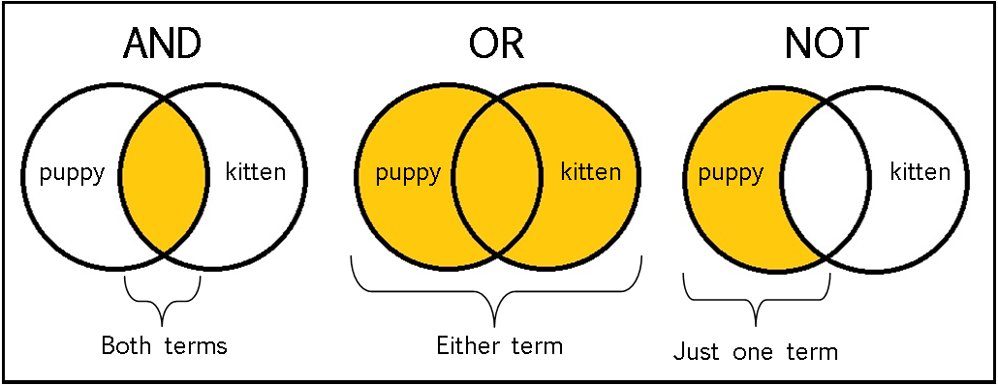
Boolean Search

Slide 32
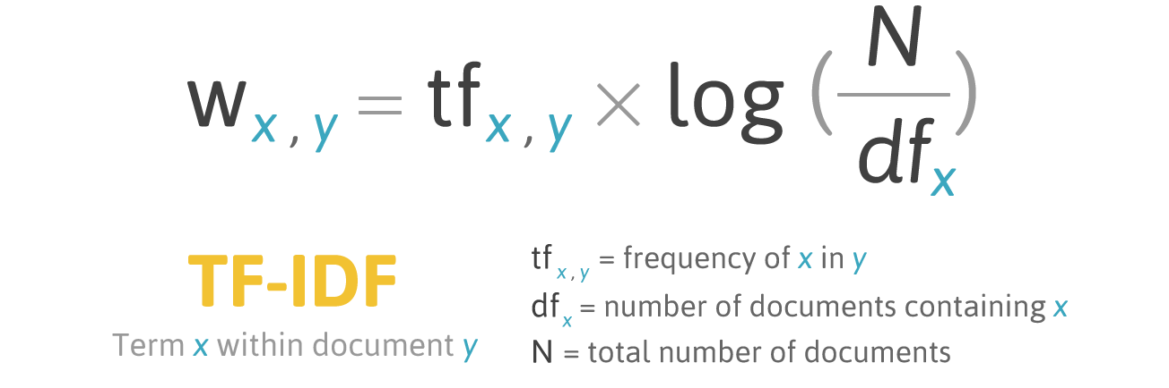

Slide 33
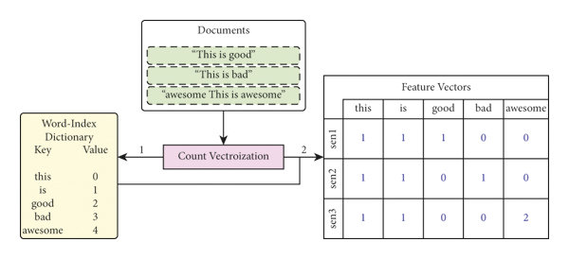
TF-IDF

Slide 34
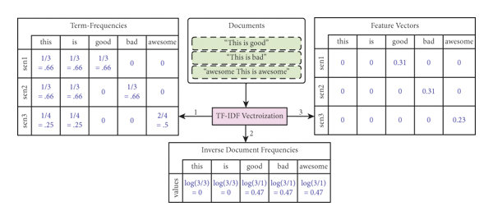
TF-IDF

Slide 35
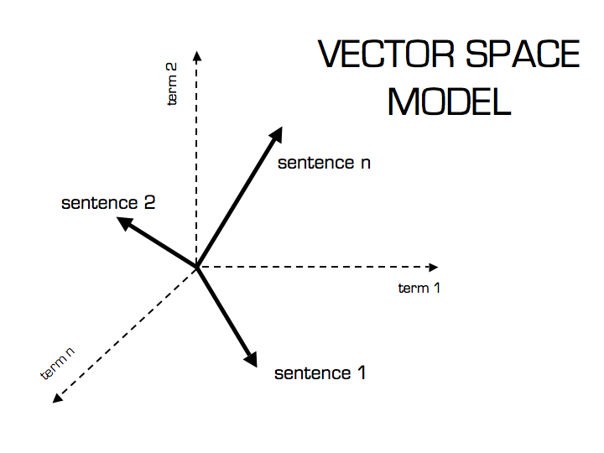
Documents as Vectors

Slide 36
Index
How to match your term (query) to a result in non-linear time?
Find / Grep: Sequential (linear) search for term
Index: Find term locations immediately
Linux command Stands for “Global Regular Expression Print”
Used to find text in documents

Slide 37
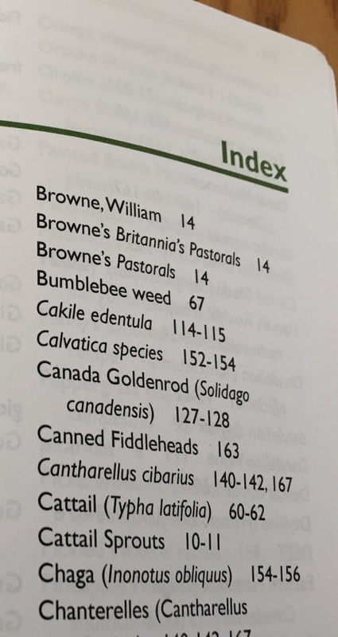
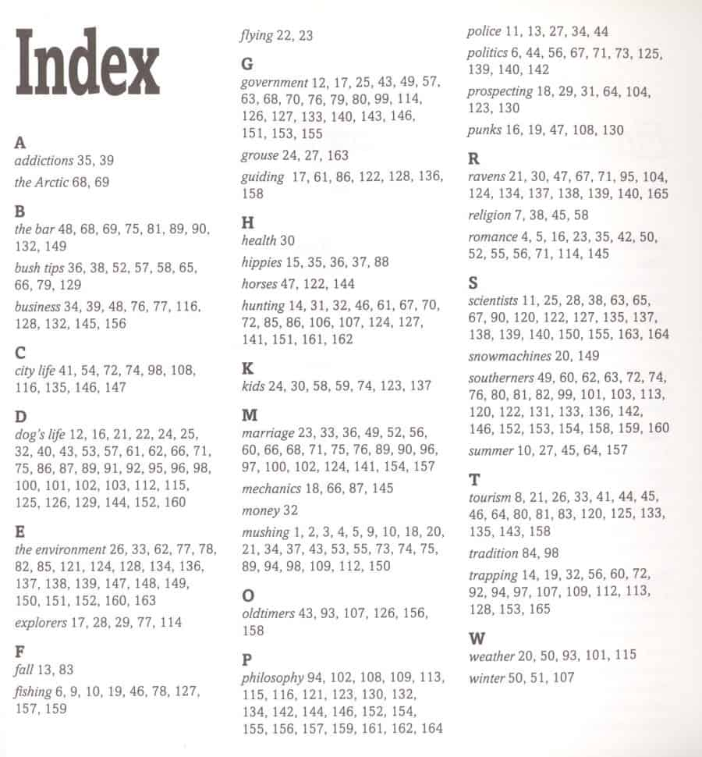
Books

Slide 38
Document Vectors
Representing documents as vectors
Vector → Document, Each cell → term
Values: term frequency or binary (0/1)
All documents → collection matrix
he | drink | ink | likes | pink | wink | thing
2 | 1 | 0 | 2 | 0 | 1 | 0 | → D1: He likes to wink, he likes to drink
1 | 3 | 0 | 1 | 0 | 0 | 0 | → D2: He likes to drink, and drink, and drink
1 | 1 | 1 | 1 | 0 | 0 | 1 | → D3: The thing he likes to drink is ink
1 | 1 | 1 | 1 | 1 | 0 | 0 | → D4: The ink he likes to drink is pink
1 | 1 | 1 | 1 | 1 | 1 | 0 | → D5: He likes to wink, and drink pink ink
# of occurrence of the term in the document

Slide 39
Inverted Index
Representing terms as vectors
Vector → term, Each cell → document
Transpose of the collection matrix
Vector → Inverted List
he | drink | ink | likes | pink | wink | Thing
2 | 1 | 0 | 2 | 0 | 1 | 0 | → D1: He likes to wink, he likes to drink
1 | 3 | 0 | 1 | 0 | 0 | 0 | → D2: He likes to drink, and drink, and drink
1 | 1 | 1 | 1 | 0 | 0 | 1 | → D3: The thing he likes to drink is ink
1 | 1 | 1 | 1 | 1 | 0 | 0 | → D4: The ink he likes to drink is pink
1 | 1 | 1 | 1 | 1 | 1 | 0 | → D5: He likes to wink, and drink pink ink

Slide 40
Creating an Inversed Index
Docs
drink
(1, 1:8) | (2, 3: 4, 6, 8) | (3, 1:6) | (4, 1:6) | (5, 1:6)
wink
(1, 1:4) | (5, 1:4)

Slide 41
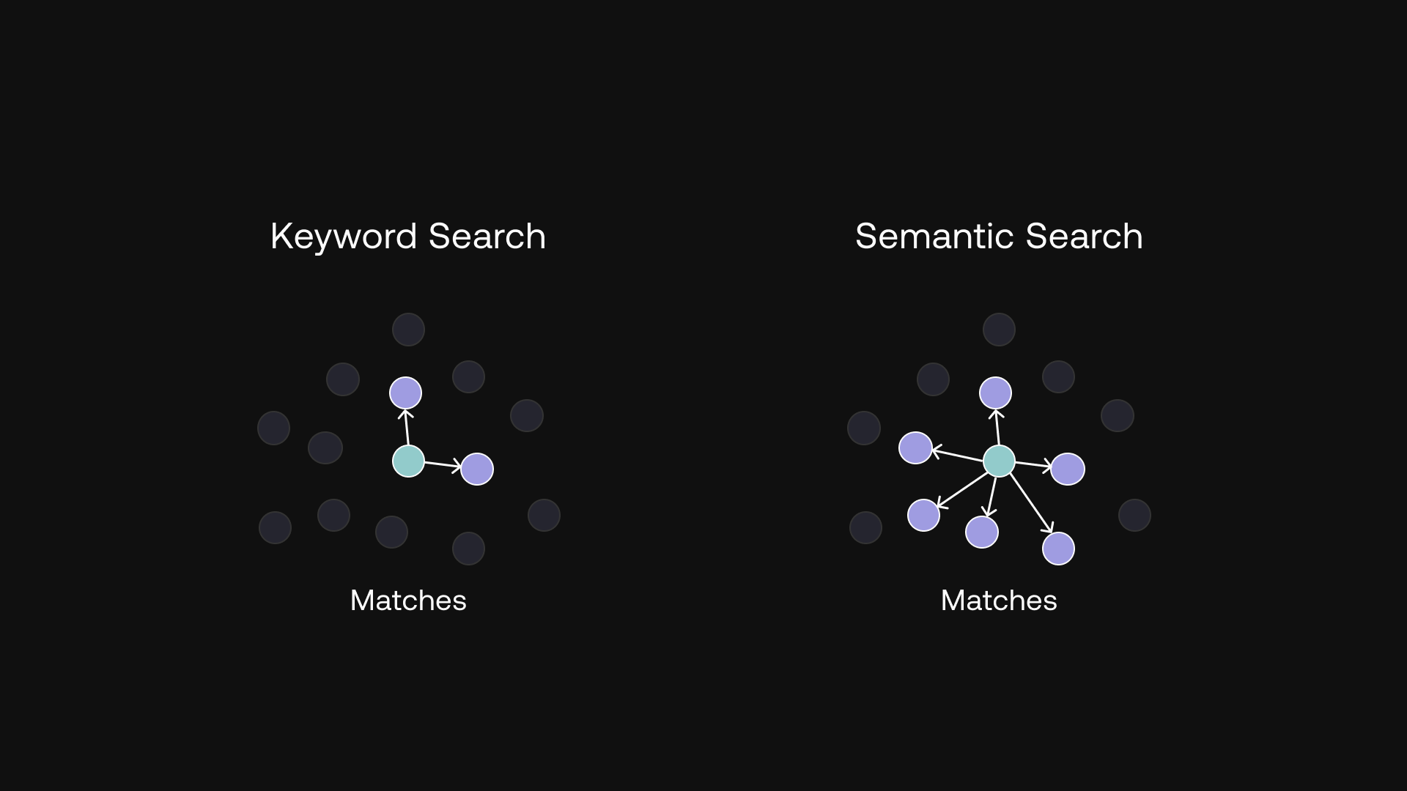

Slide 42
Keywords Search
Query: Where is the world cup?
Responses:
1 – The world cup is in Qatar
2 – The sky is blue
3 – The bear lives in the wood
4 – An apple is a fruit
Keyword search looks for the response with the largest number of words in common.

Slide 43
Keywords Search
Query: Where is the world cup?
Responses:
1 – The world cup is in Qatar (4 words in common)
2 – The sky is blue (2 words)
3 – The bear lives in the wood (2 words)
4 – An apple is a fruit (1 words)
Keyword search looks for the response with the largest number of words in common.

Slide 44
Keywords Search
But this may be pure luck.
Imagine we had another response: “Where in the world is my cup of coffee?” (5 words in common)
Query: Where is the world cup?
Responses:
1 – The world cup is in Qatar (4 words in common)
2 – The sky is blue (2 words)
3 – The bear lives in the wood (2 words)
4 – An apple is a fruit (1 words)
Keyword search looks for the response with the largest number of words in common.

Slide 45
Keywords Search vs Semantic Search
Optional solution to fix:
Remove stop-words (“the”, “and”, “is”, …)
Use TF/IDF to select only key terms
Or - Semantic Retrieval:
Represent documents as vectors using text-embedding
Find the nearest vectors, based on some distance-metric

Slide 46
Semantic retrieval

Slide 47
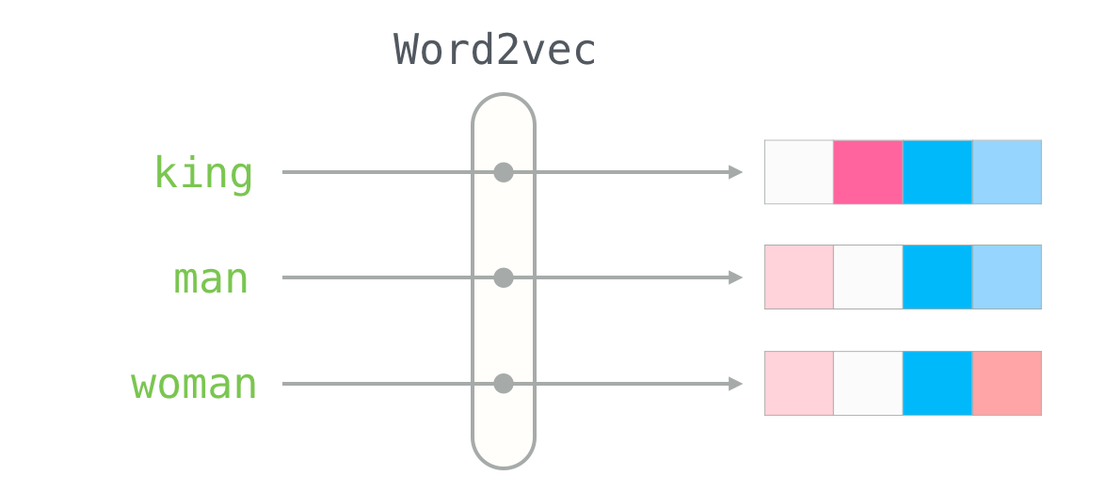

Slide 48
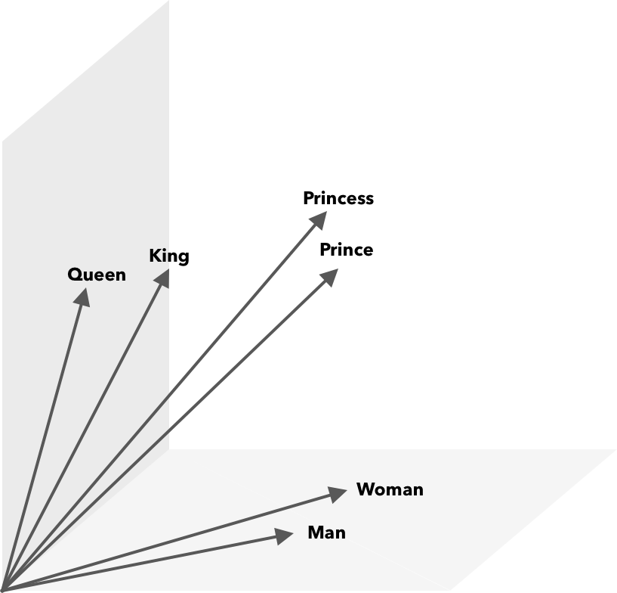
Word2Vec

Slide 49
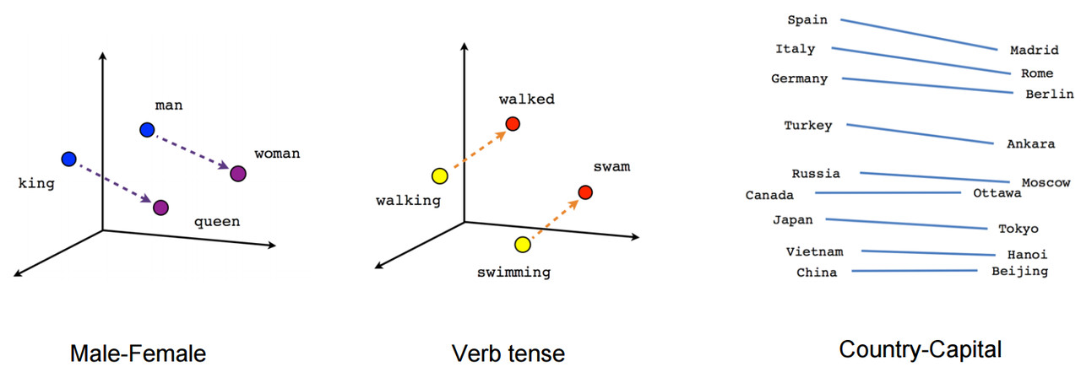
Word2Vec
Embedding projector - visualization of high-dimensional data

Slide 50
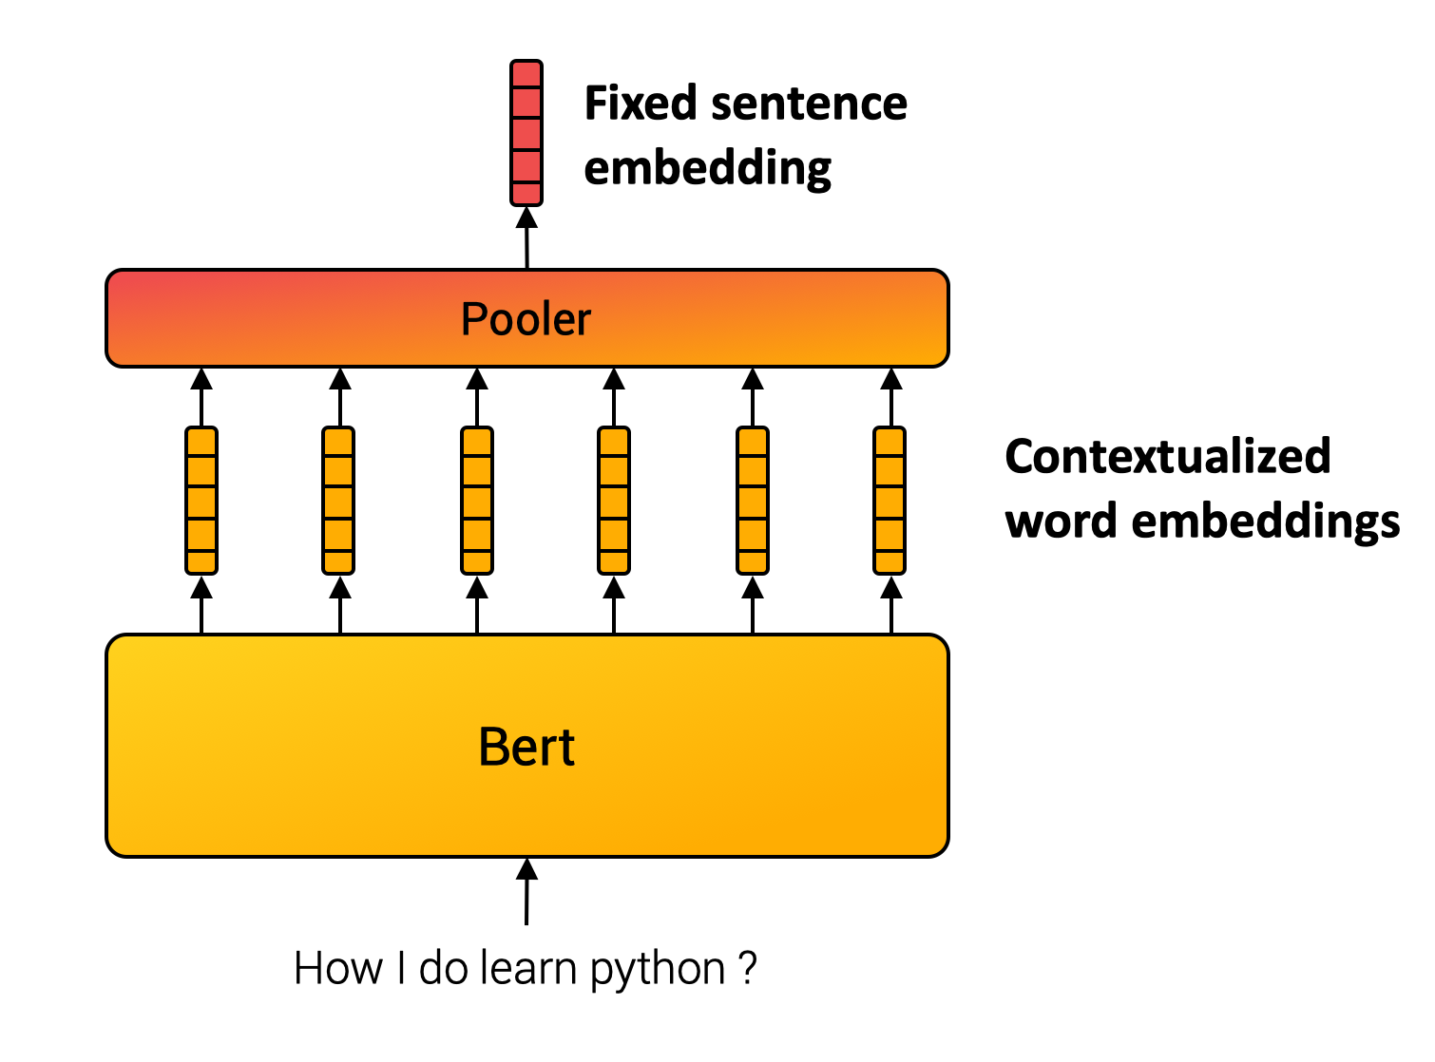
Embedding a Sentence / Document

Slide 51
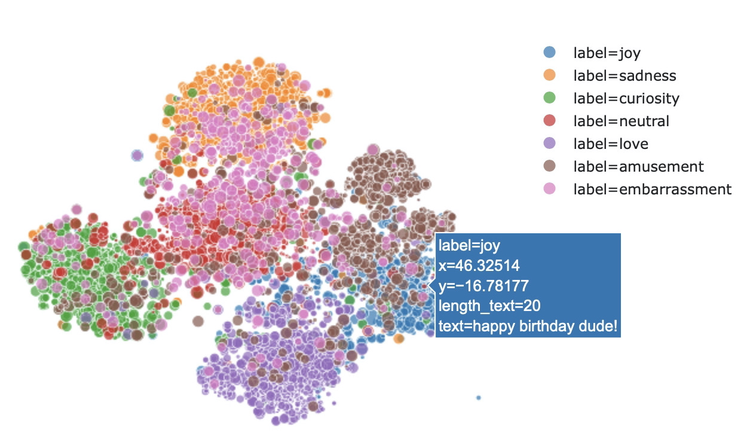
Sentence Embedding
[1805.01070] What you can cram into a single $&!#* vector: Probing sentence embeddings for linguistic properties

Slide 52
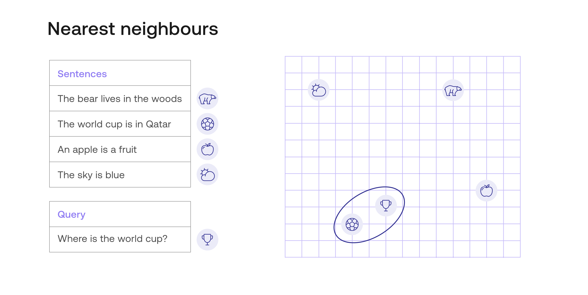

Slide 53
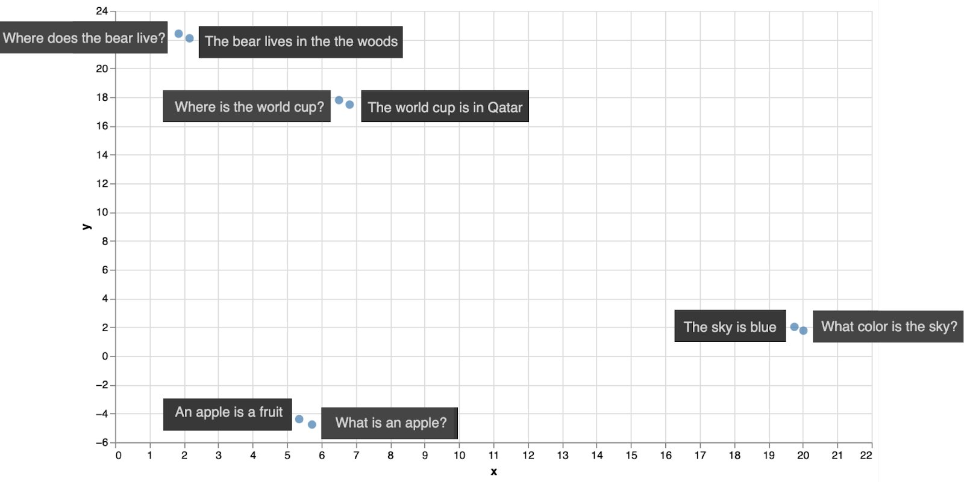

Slide 54
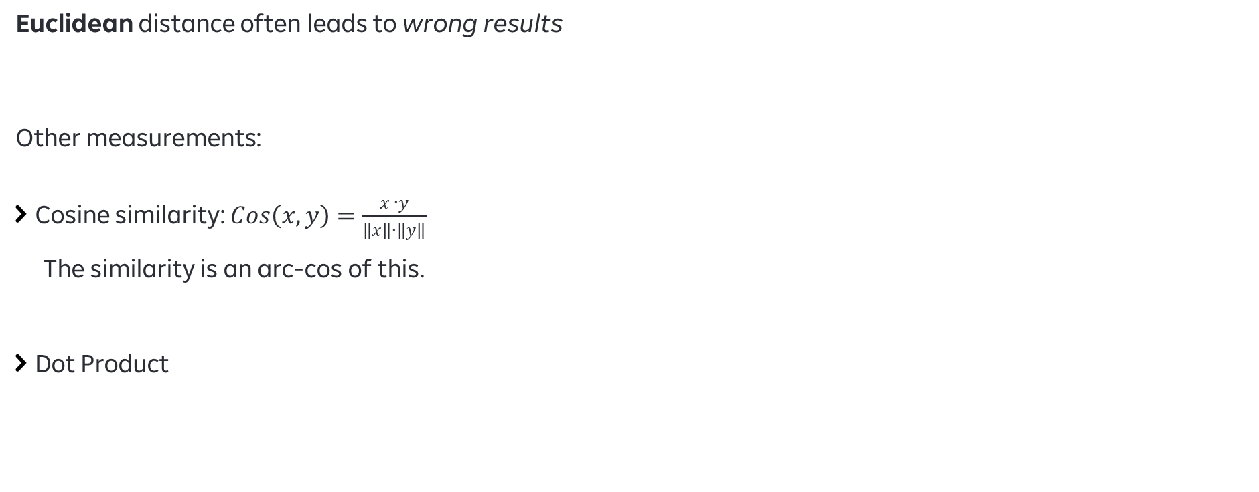
Similarity Measures
Euclidean distance often leads to wrong results
Other measurements:
Cosine similarity: $Cos\left(x,y\right)=\frac{x ∙y}{\left\|x\right\|∙\left\|y\right\|}$
The similarity is an arc-cos of this.
Dot Product

Slide 55
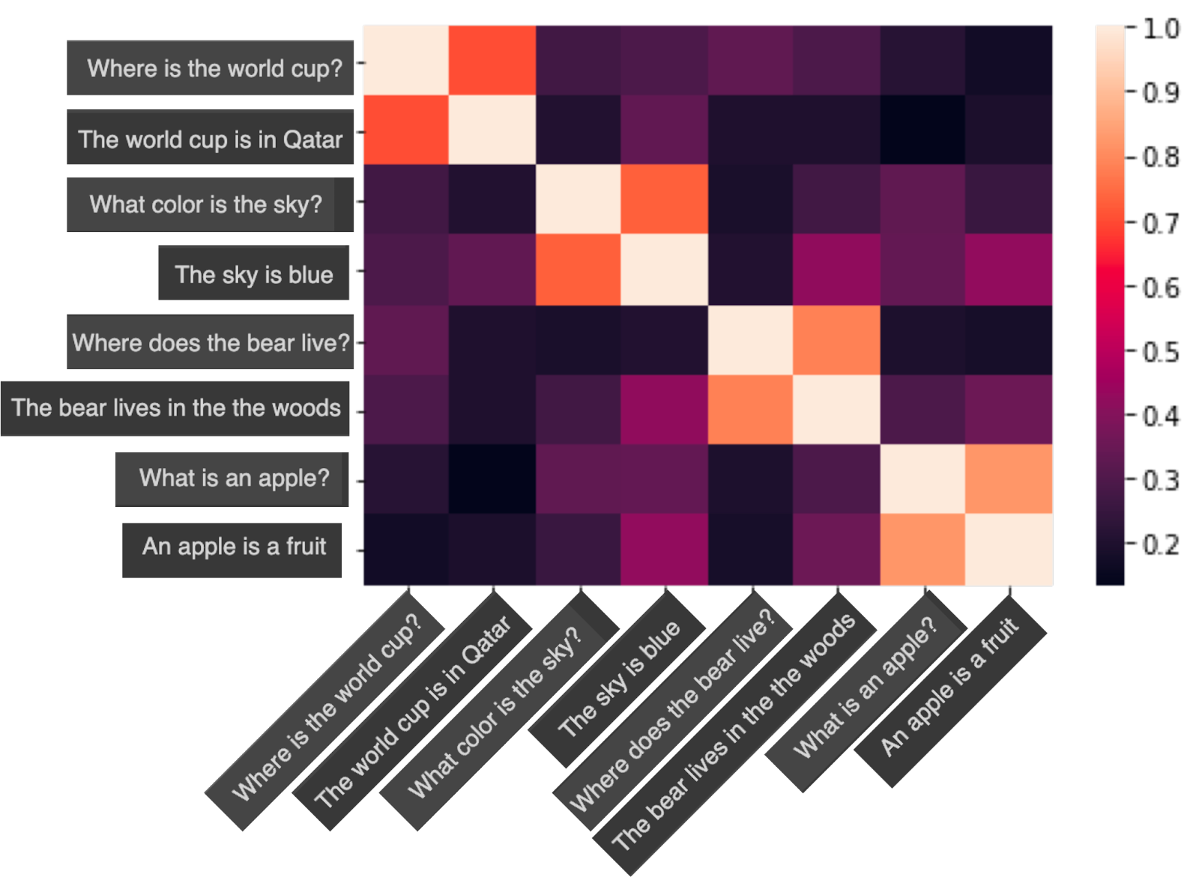

Slide 56
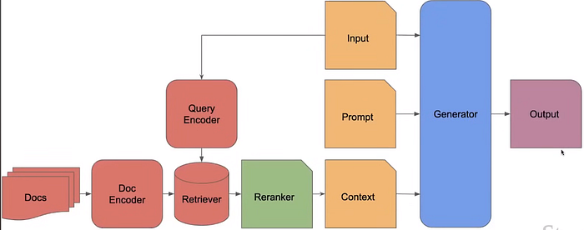
Information Retrieval

Slide 57
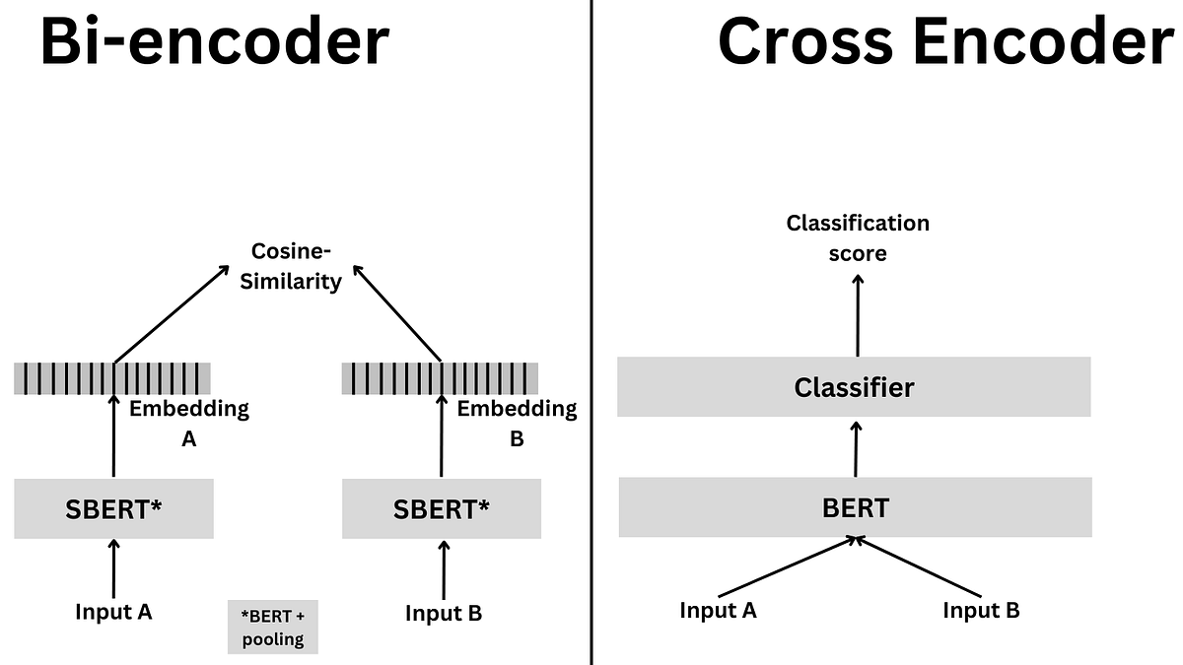
How does it help us?

Slide 58
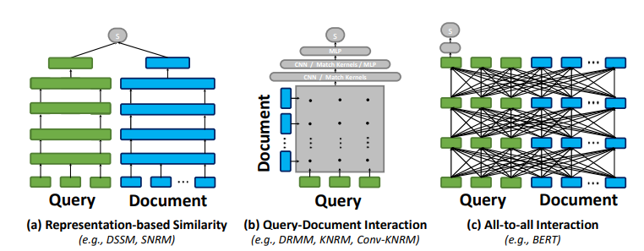
Learned Semantic Similarity
[2004.12832] ColBERT: Efficient and Effective Passage Search via Contextualized Late Interaction over BERT

Slide 59
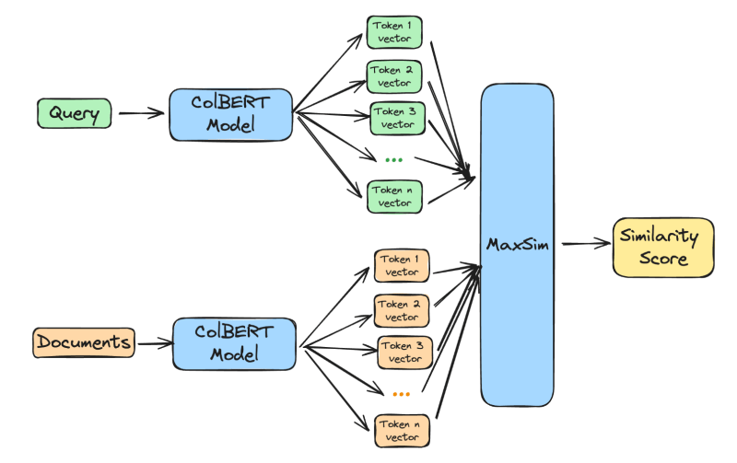
ColBERT
[2004.12832] ColBERT: Efficient and Effective Passage Search via Contextualized Late Interaction over BERT

Slide 60
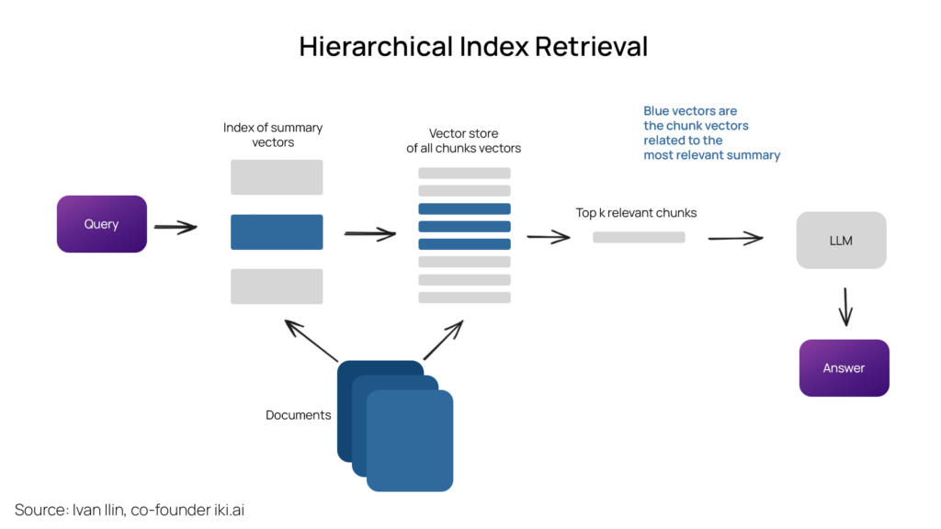
Storing Vectors

Slide 61
Index Storage
A Partial List
FAISS
Milvus
Qdrant
Pinecone
MongoDB
PostgreSQL

Slide 62
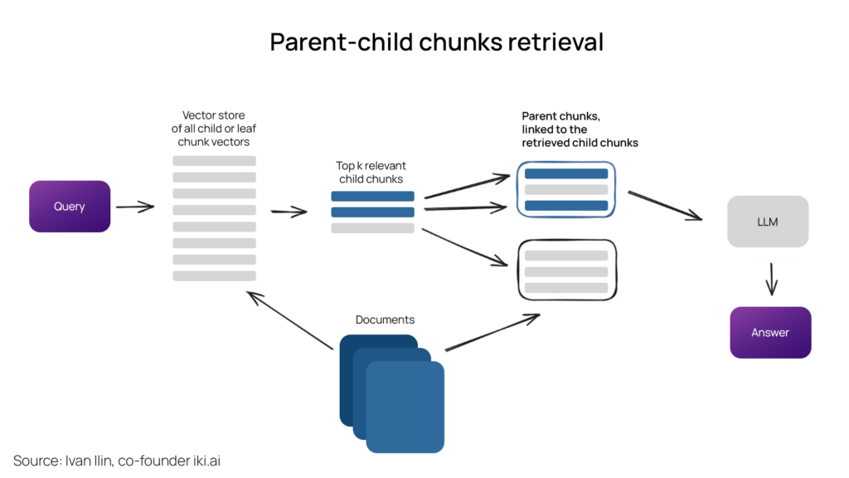
Dividing a Long Document into Chunks

Slide 63
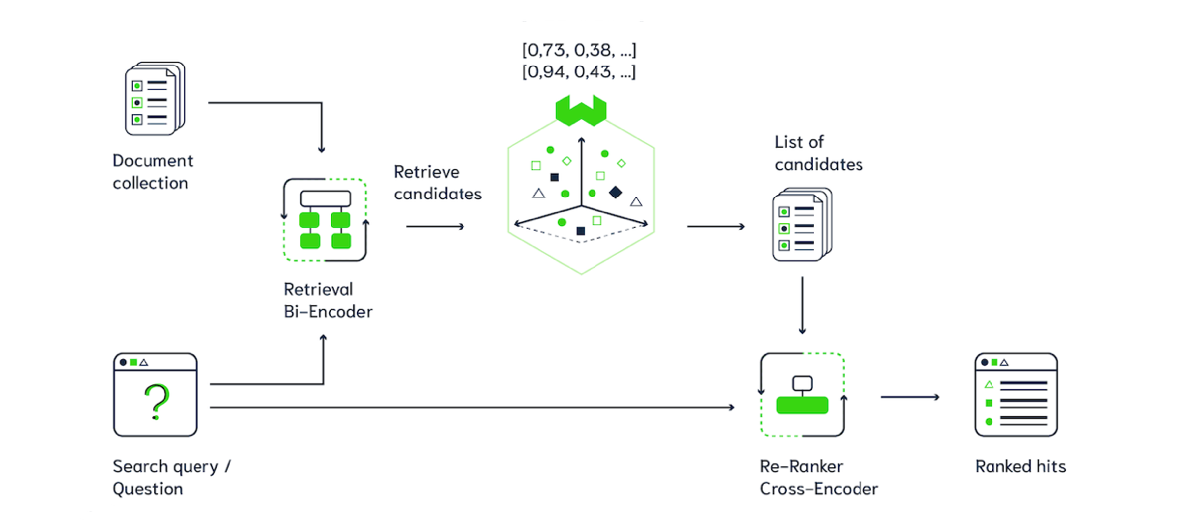
The Big Picture
Cheap Bi-Encoder to get promising candidates
Wrap the content & query with an LLM Prompt
Cross-Encoder on promising candidates only

Slide 64
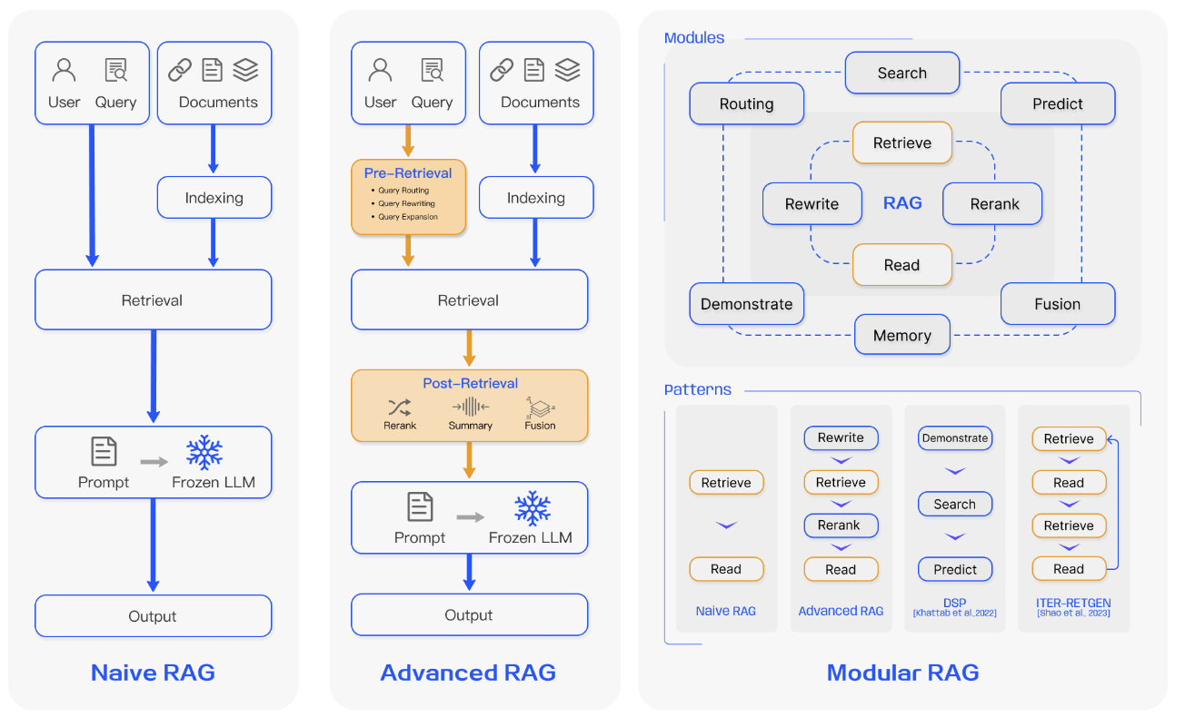
Advanced Retrieval-Augmented Generation (RAG)

Slide 67
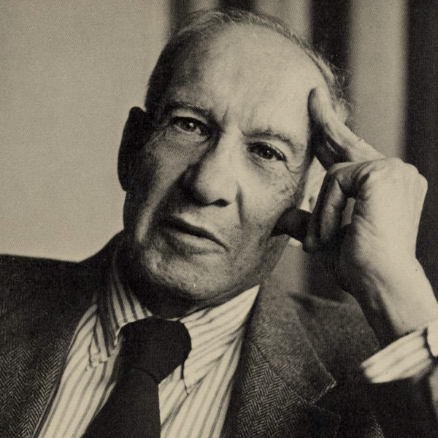
What gets measured gets done
Peter Drucker

Slide 68
What should we measure in retrieval systems?

Slide 69
Good Effectiveness Measures
Should capture some aspect of user satisfaction
Should be able to be replicated/reproduced
Should be comparable
E.g., a single number
Should have predictive values for other situations
Different queries on different document-collections

Slide 70
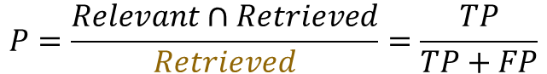
Precision
Precision: What fraction of the retrieved docs is relevant?
How good are the results?
Irrelevant | FP | TN
Relevant | TP | FN
 | Retrieved | Not retrieved
Retrieved Documents
Relevant Documents
$$P=\frac{Relevant∩Retrieved}{Retrieved}=\frac{TP}{TP+FP}$$

Slide 71
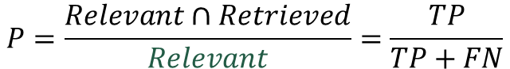
Recall
Recall: What fraction of the relevant documents is retrieved?
Did we forget anything?
Irrelevant | FP | TN
Relevant | TP | FN
 | Retrieved | Not retrieved
Retrieved Documents
Relevant Documents
$$P=\frac{Relevant∩Retrieved}{Relevant}=\frac{TP}{TP+FN}$$

Slide 72
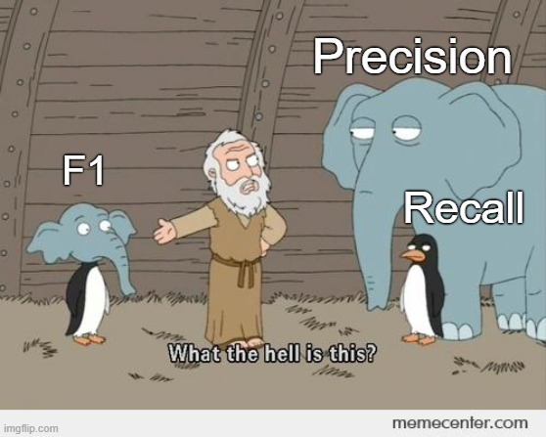
F1-Score

Slide 73
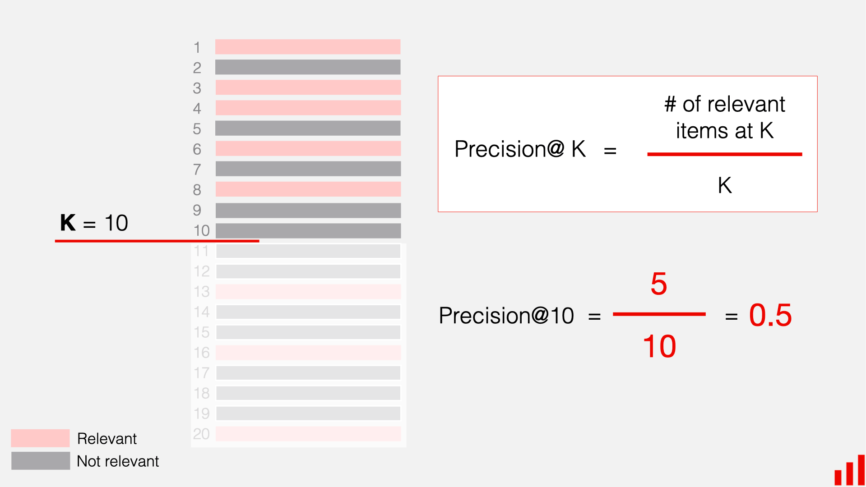
Precision@k

Slide 74
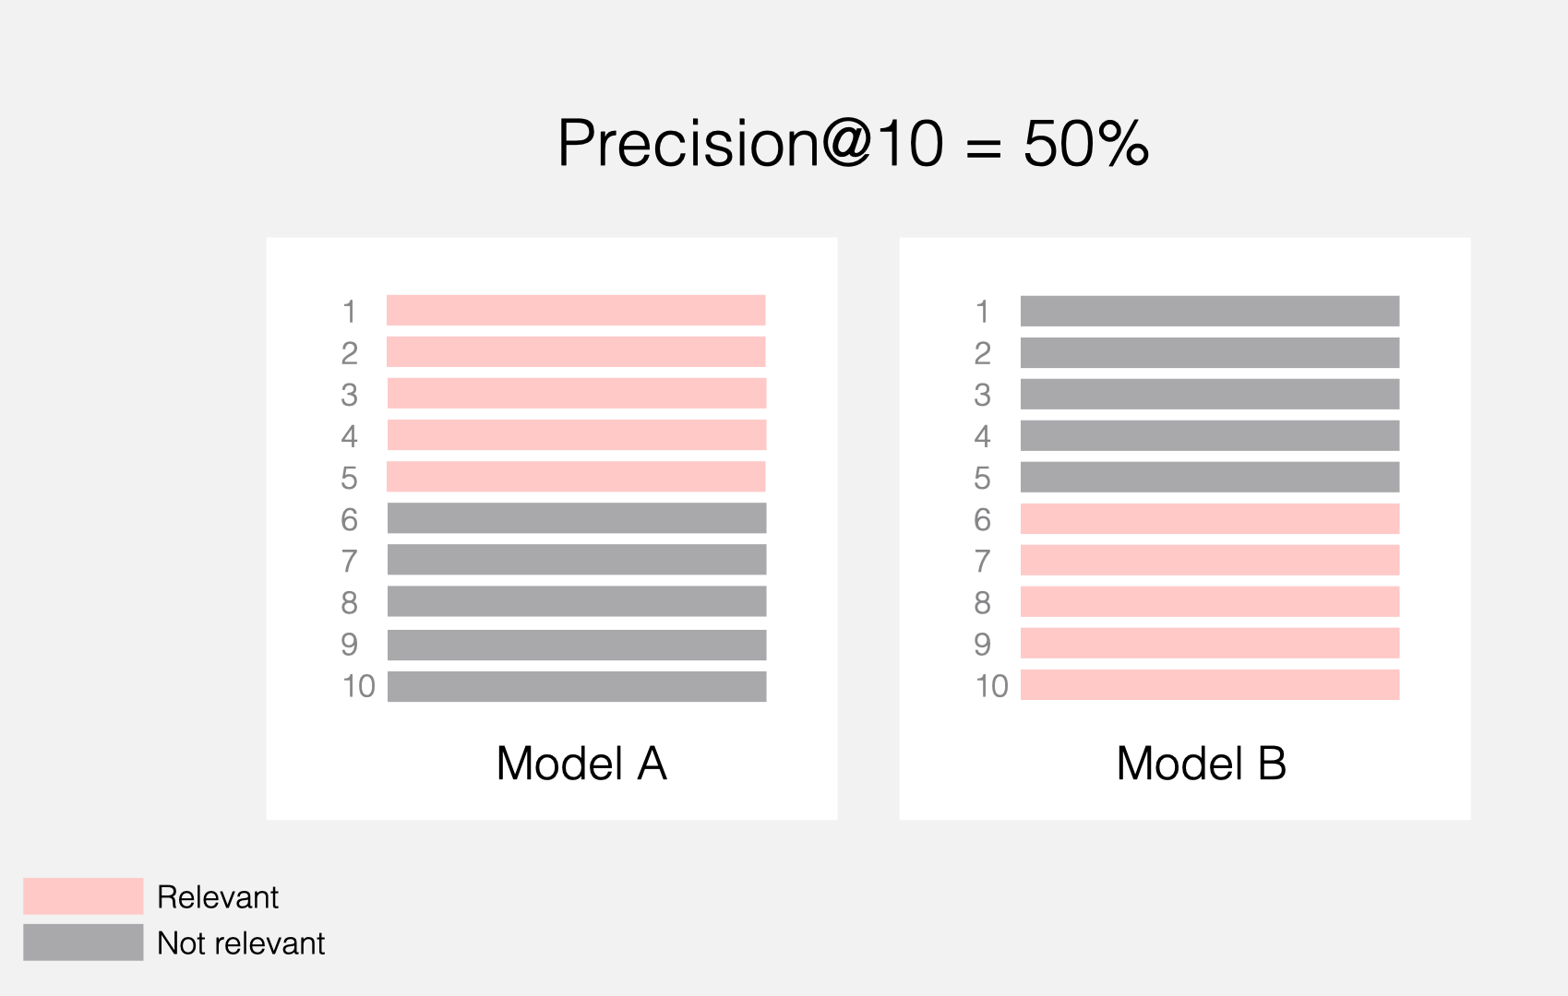
Precision@k – not so precise after all!
?

Slide 75
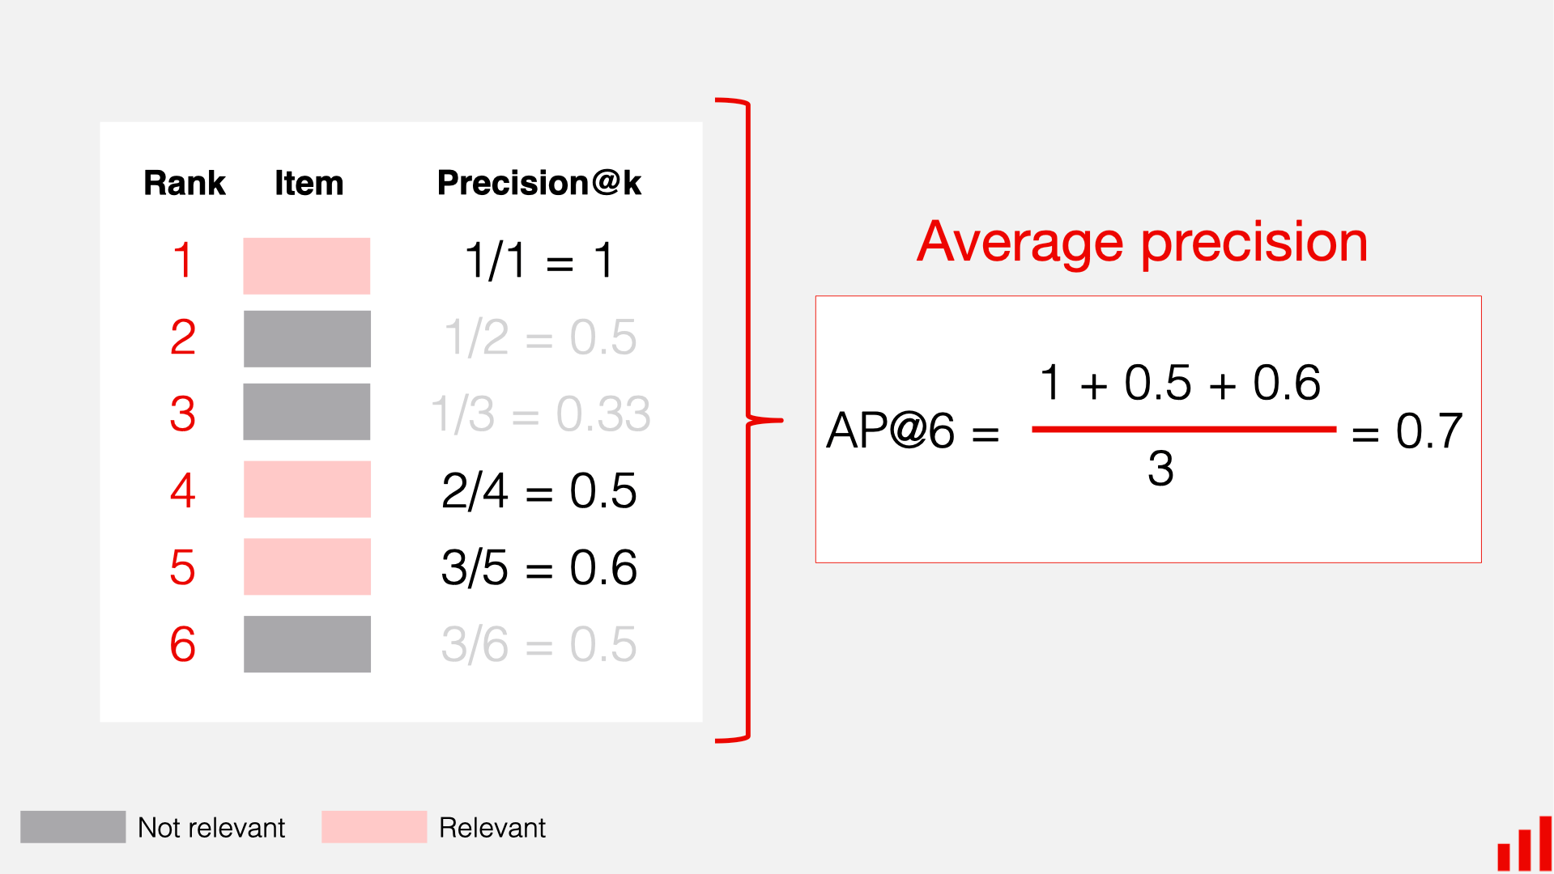
Mean Average Precision (MAP)

Slide 76
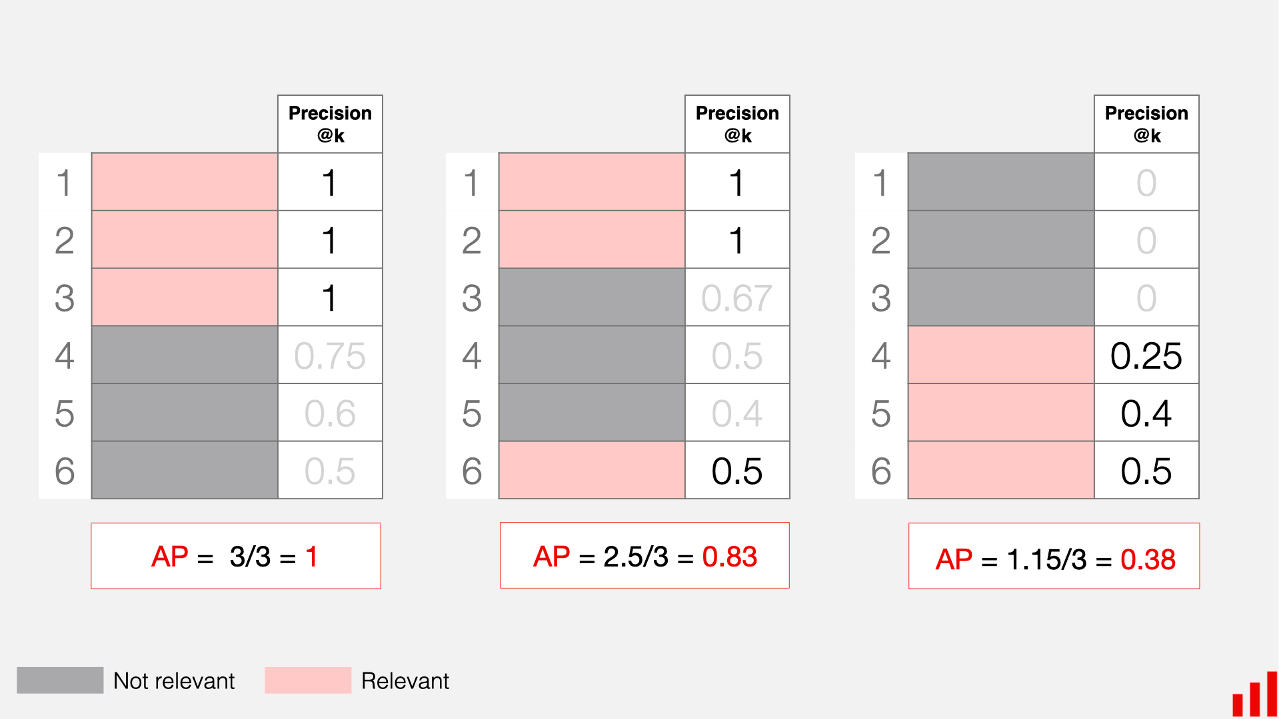
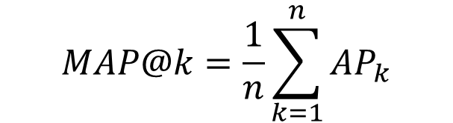
MAP in Action
$$MAP@k=\frac{1}{n}\sum_{k=1}^{n}{AP_{k}}$$

Slide 77
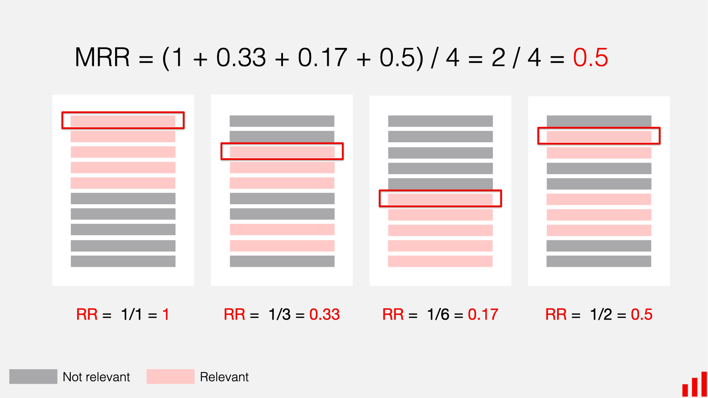
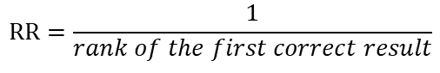
Mean Reciprocal Rank (MRR)
$$RR=\frac{1}{rank of the first correct result}$$

Slide 78
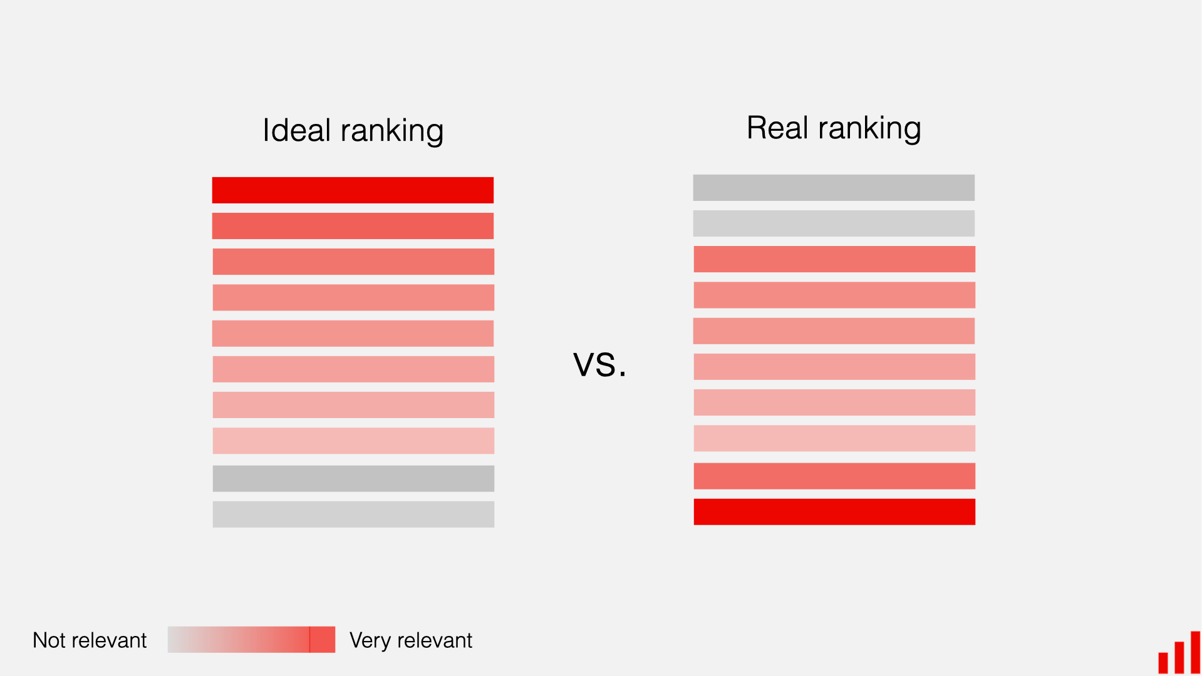
Normalized Discounted Cumulative Gain (nDCG)

Slide 79
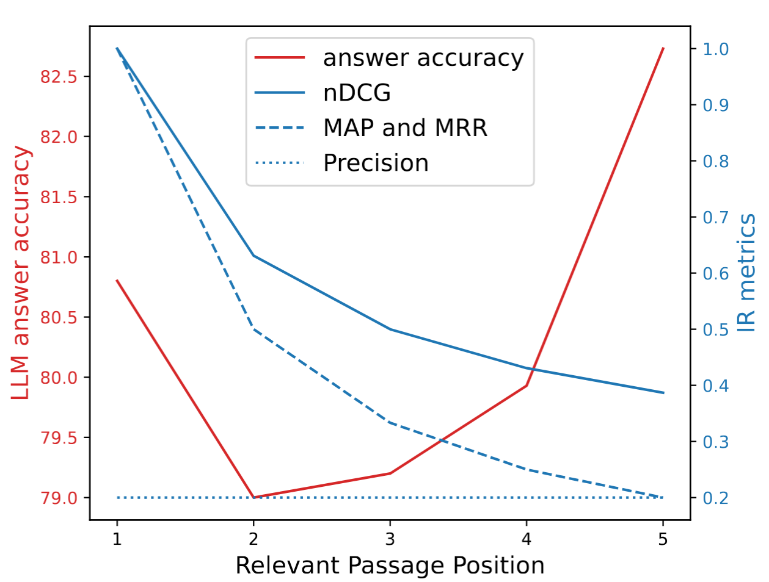
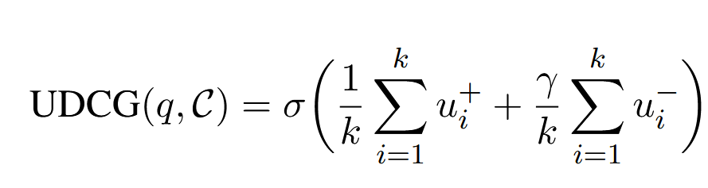
Evaluation Results Metrics – for Humans, not for LLMs
Utility and Distraction-aware
Cumulative Gain (UDCG):
Precision is position-agnostic
[2510.21440] Redefining Retrieval Evaluation in the Era of LLMs
GiovanniTRA/UDCG: Code and Data of the paper: "Redefining Retrieval Evaluation in the Era of LLMs"

Slide 80
Evaluating Generative Responses

Slide 81
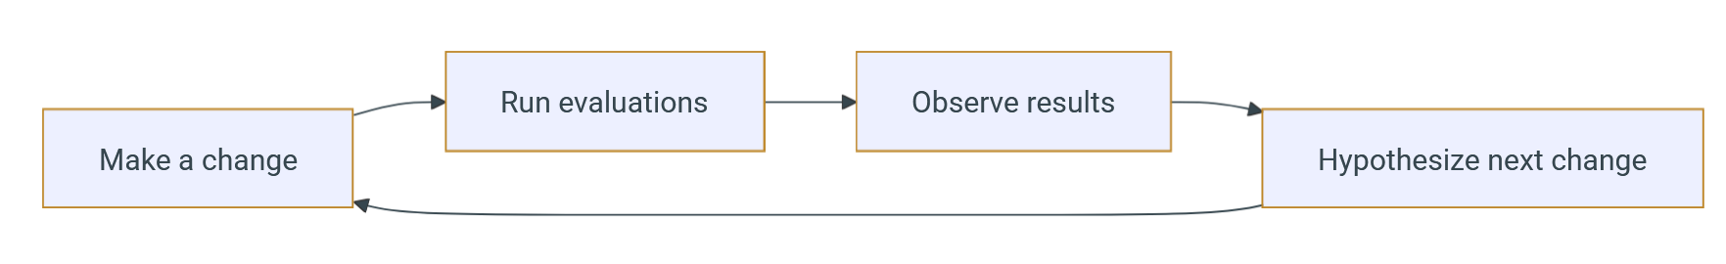
Evaluating RAG Output
vibrantlabsai/ragas: Supercharge Your LLM Application Evaluations 🚀 (Open-Source!)
OpenLIT | OpenTelemetry-native GenAI and LLM Application Observability (Open-Source!)
Langfuse
Helicone / AI Gateway & LLM Observability
Laminar
Traceloop - LLM Reliability Platform
embeddings-benchmark/mteb: MTEB: Massive Text Embedding Benchmark

Slide 82
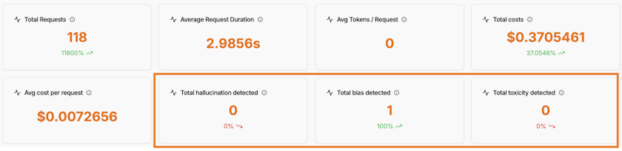
Evaluating RAG Output
Keyword detection
LLM-as-a-Judge
Toxicity & Bias detection

Slide 83
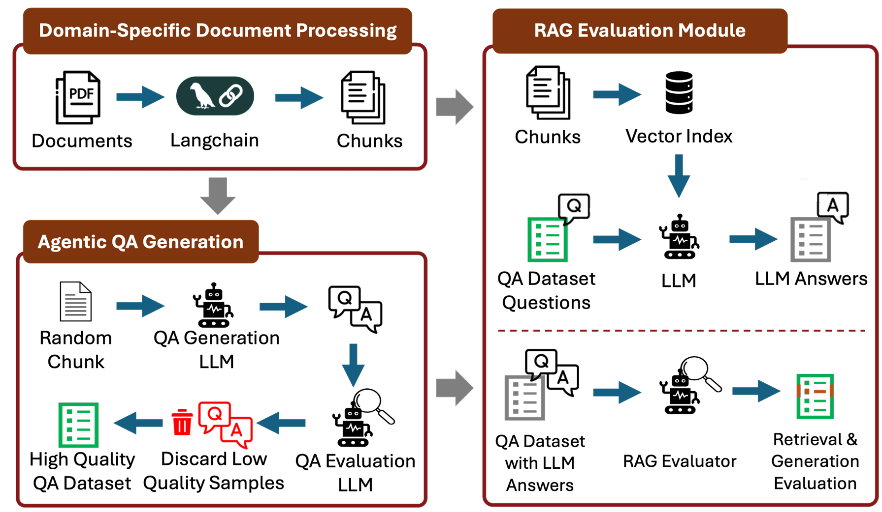
RAGalyst
[2511.04502] RAGalyst: Automated Human-Aligned Agentic Evaluation for Domain-Specific RAG
Notes:
LLM produces synthetic question–answer context datasets

